Slide 1
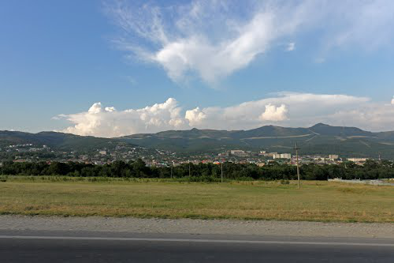
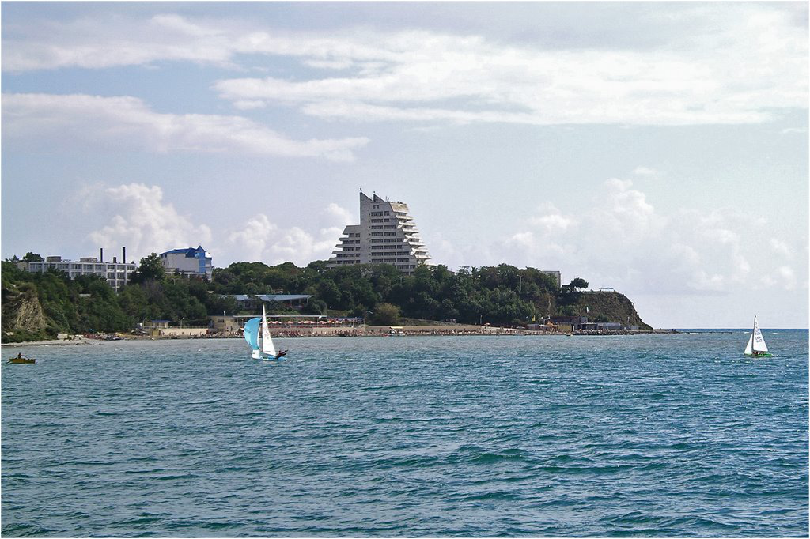
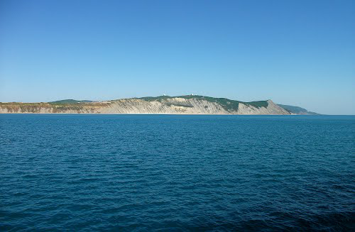
Anapa Airbase
A Co-Op
Mission
Blue Team Briefing
1. Primary Task: Eliminate Russian SA-10 installation
2. Secondary Task: Destroy Russian Su-34 planes
3. Operational Task: Capture Georgian radars.
4. Operational Task: Destroy SAMs between Gudauata and Anapa
Next Page ➔

Slide 2
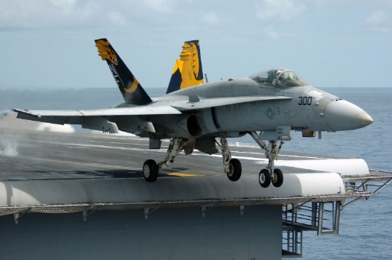
Situation
The Krasnodar region is of extreme
strategic importance to NATO. The USA has
sent a large fleet of ships to dominate the region. Anapa airbase is still occupied by Russia and is in danger.
Assist the NATO infantry troops to acquire Anapa airbase. Once the airbase has been captured, NATO has full dominance of the region. Eliminate Russian air defenses, especially the Su-34 anti-ship attack planes.
Next Page ➔

Slide 3
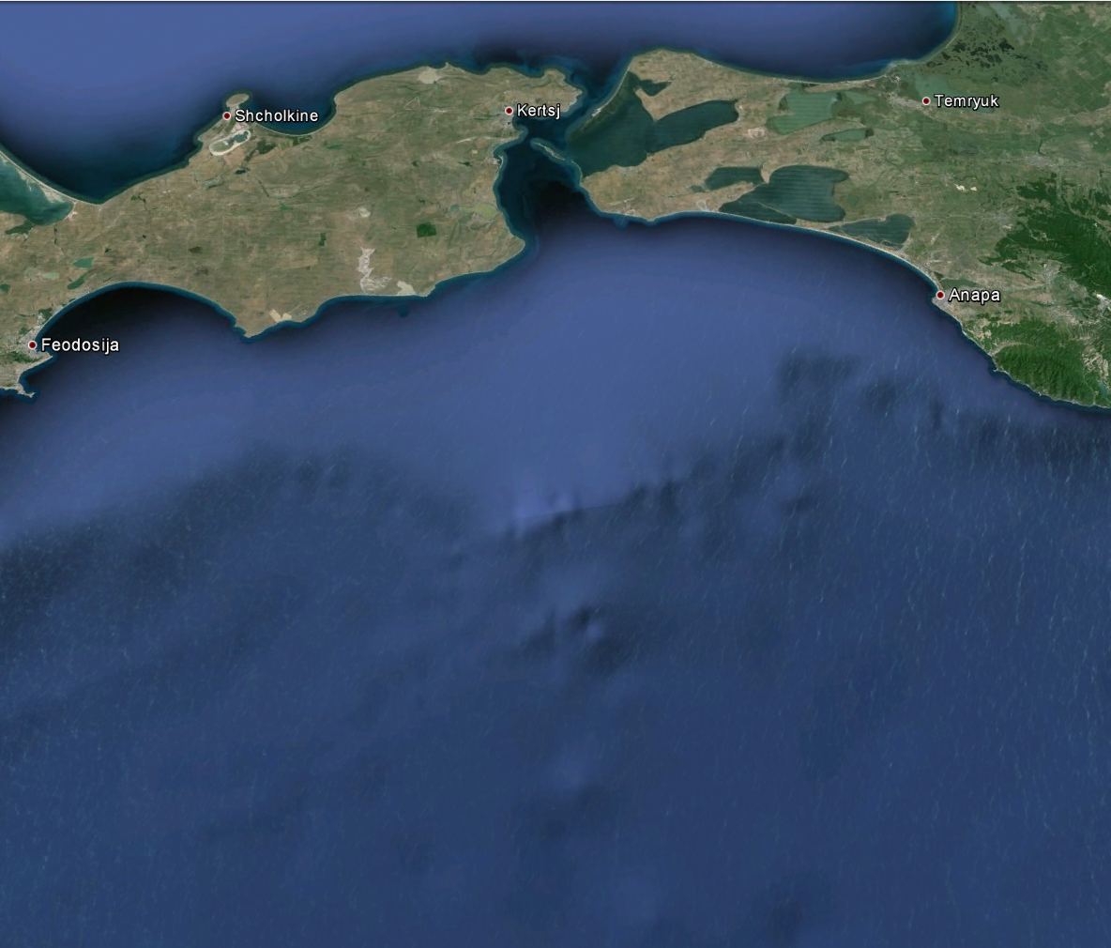
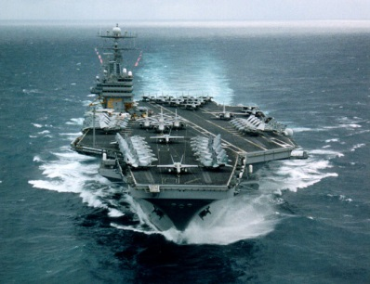
Situation
Northern USA Ships
Russia
NATO
Oil platforms
USA fleet approaching from the west
NATO Air support from Gudauata
Town: Anapa
Next Page ➔

Slide 4
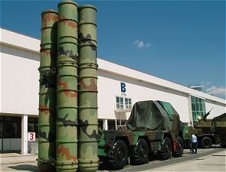

Primary Task
Eliminate Russian SA-10 installation.
Russia has a large S-300 (SA-10 Grumble) long range air defense installation deployed near Anapa airbase.
NATO must destroy this air defense installation to obtain full control over the airspace above Anapa. After the elimination of the SA-10 installation, NATO will increase its air attack.
Take-Off from Gudauata or from mid-air and eliminate the SA-10 using A-10As, A-10Cs or KA-50 helicopters from the ships.
USA western ship fleet for KA-50 support + F18/AC AI support
Estimated location of the SA-10 installation
A-10A, A-10C attack
Next Page ➔

Slide 5
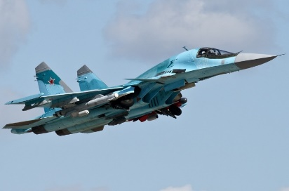
Secondary Task
Destroy Russian Su-34 anti-ship planes
Russia as a large fleet of anti-ship Su-34 planes near Krasnodar, who are operational within the Krymsk airspace. The Su-34 planes are armed with KH-31A/P active and passive anti radiation missiles, which can destroy a ship after 6 direct hits. To secure our infantry deployment operations from the north, these planes must be eliminated. Take-off from Gudauta with our F-15C or Mirage-2000C planes and destroy the Su-34.
Northern Ship Attacks
Western Ship Attack
Estimated location of the Su-34 planes orbiting.
Next Page ➔

Slide 6
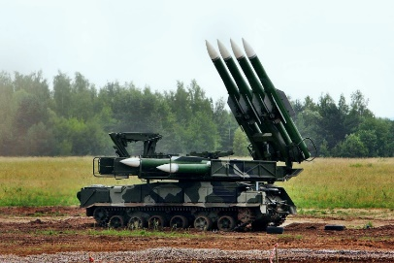
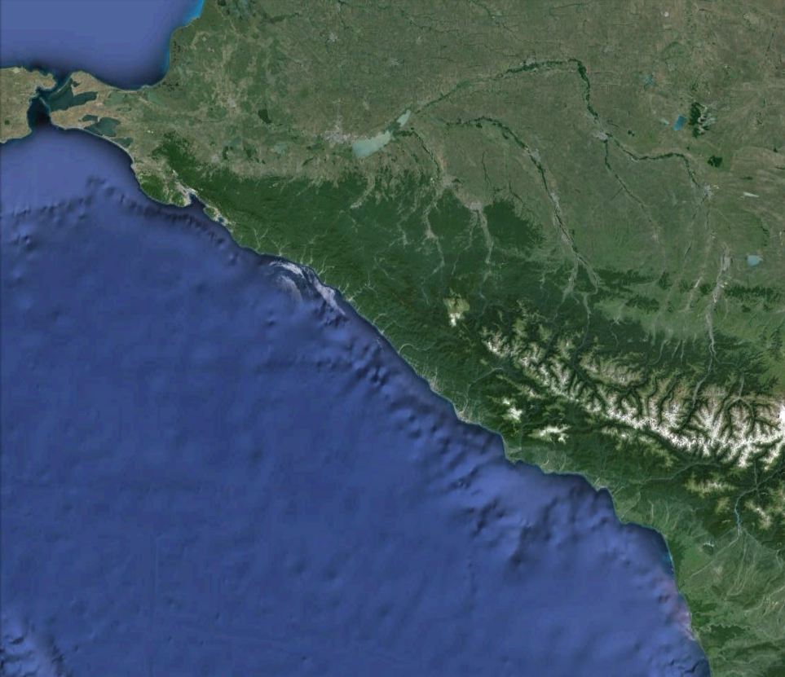
Operational Task
Destroy SAMs between Gudauata and Anapa.
Various mobile Russian SAM units (SA-6, SA-11) are patrolling between Gudauta and Anapa. Use the Georgian Su-25T SEAD attack planes or the USA A-10As, A-10Cs to eliminate these SAM defenses. It will make the route to Anapa much more secure for our F-15C air defenses. Watch out for AAA hidden in the mountains. Beware that these Russian SAMs are awaiting our attacks, and may (will) disengage their radars and relocate after your missile launch to evade the attack.
Anapa
Mountains
Estimated location of the mobile SAMs
Gudauata airbase
Next Page ➔

Slide 7
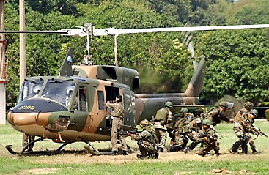
Operational Task
Transport USA engineers to capture 3 Russian radar defenses.
USA engineers are awaiting redeployment to capture 3 Russian radar defenses. Fly the UH-1H helicopters from the northern farps to load our USA engineers at the pickup zone and capture the 3 Russian radar defense installations in the north of Anapa. Expect light armed Russian defenses near the radars. Deploy our USA engineers and they will capture the radar installations. Your co-pilot will provide you with directions during flight.
Pickup USA engineers at
Northern
FARPs
Anapa Defenses
Location of the Russsian radar installations
Next Page ➔

Slide 8
Anapa Airbase
A Co-Op
Mission
Red Team Briefing
1. Primary Task: Destroy Northern USA ship vessels
2. Secondary Task: Destroy USA CH-53E helicopters
3. Operational Task: Stop the approaching USA infantry
4. Operational Task: Rescue workers from the oil platform
Next Page ➔

Slide 9
Situation
The Krasnodar region is of extreme
strategic importance to NATO. The USA has
sent a large fleet of ships to dominate the region. Anapa airbase is still occupied by Russia and is in danger.
Defend the Anapa airbase from the upcoming USA forces. Eliminate NATO infantry troops on their way to Anapa, and destroy the ship vessels.
Next Page ➔

Slide 10
Situation
Northern USA Ships
Russia
NATO
Oil platforms
USA fleet approaching from the west
NATO Air support from Gudauata
Town: Anapa
Next Page ➔

Slide 11
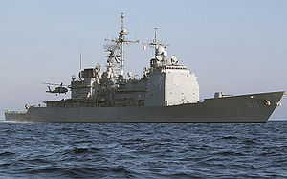
Primary Task
Destroy Northern USA ship vessels
There are 3
ship vessels in the
North that must be destroyed to avoid a large USA infantry force approaching Anapa. Fortunately, our Krymsk Su-34 anti-ship air fleet is nearby and is assisting with the defenses with KH-31A/P anti radiation missiles. They are awaiting your command using the radio menu while orbiting. Defend our Su-34 planes, as we only got 10 of them left! Use the Su-25T fleet at Anapa to assist with the ship SEAD attack.
Northern
FARPs
Destroy Ships
Estimated location of the Su-34 planes.
Next Page ➔

Slide 12
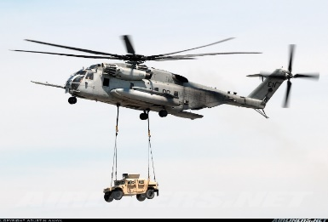
Secondary Task
Destroy USA CH-53E helicopters
The USA has a large helicopter deployment force within the Northern region of Anapa operational. They are re-deploying large infantry mobile units from the ships to land. These infantry forces will immediately start their way to Anapa airbase to capture it. Destroy these helicopters to secure our airbase. Note that there are SAMs defending the deployment zones. Fly the Su-27 and Su-33 and the Mig-29S to eliminate these helicopters.
Landing Zones
Destroy CH-53E
Next Page ➔

Slide 13
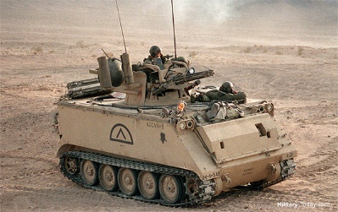
Operational Task
Stop the upcoming USA infantry.
The large USA infantry units are approaching Anapa. Note that the size of the USA infantry largely depends on the effectiveness of the Russian attacks to the Northern ships and helicopter deployments. Destroy the approaching infantry using our KA-50 helicopters, or our Su-25T and Su-27 ground defenses.
Infantry deployment
Air Defenses
Next Page ➔

Slide 14
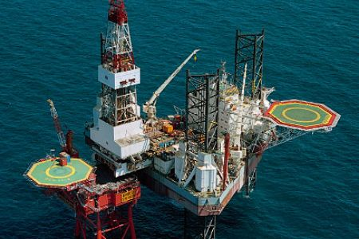
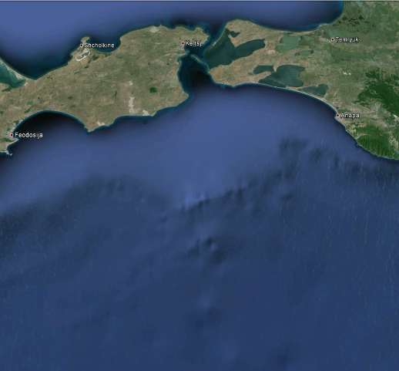
Operational Task
Rescue workers from the oil platform
Oil workers are still residing on the oil platforms at sea. They must be saved as the USA fleet is approaching fast. Ensure their safetly by aboarding the Mi-8 helicopter fleet at Anapa airbase, and fly to the oil platforms. A red smoke signal indicates which platform contains the workers to be rescued. Land on the oil platform helicopter landing platform and onboard the workers. Once safe within the Mi-8 fly to Gelend to ensure their safety.
Rescue
Re-deploy
USA western ship fleet
Oil platforms
Next Page ➔

Slide 15
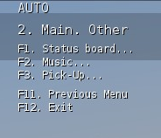
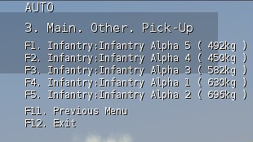
General information
Execute transport instructions using the communication menu and then selecting (F10).
During a transport flight, you will receive different instructions to load or unload packages from the helicopter. These instructions can be executed using the communication menu in DCS World. The communication menu is activated by pressing the right key on your keyboard. (default is a ‘\’). Within the communication menu, you need to press (F10) to activate further mission options.
Within the F10-Menu, options will be available to Pickup, Deploy / Load, Unload cargo, for each cargo type that is available. (Note that for transporting sling load cargo, the built-in DCS World menu system needs to be followed!)
Once you’ve selected the cargo type action menu, the next menu will show each cargo item by it’s name and weight.
Next Page ➔

Slide 16
General info
Cargo
Cargo ‘types’ can be Infantry, Packages, Sling Loads and Vehicles. Depending on the type of cargo, the communication menu will show a different menu for each cargo type that is available. Ensure that you select the correct cargo type within the correct communication menu to load/unload the correct cargo type, to accomplish your mission objectives!
Each cargo has a ‘state’, so that within the mission, the actions done with each cargo element will determine mission success or failure. Beware of this while flying a mission. F.e., if a cargo needs to be loaded/unloaded once, ensure that the cargo will be handled in this way. When flying a helicopter that is assigned for transport, you will receive a message containing the exact cargo contents within the helicopter. Note that when your helicopter crashes, the cargo will be LOST within the mission, and your mission may result in a failure!
Next Page ➔

Slide 17
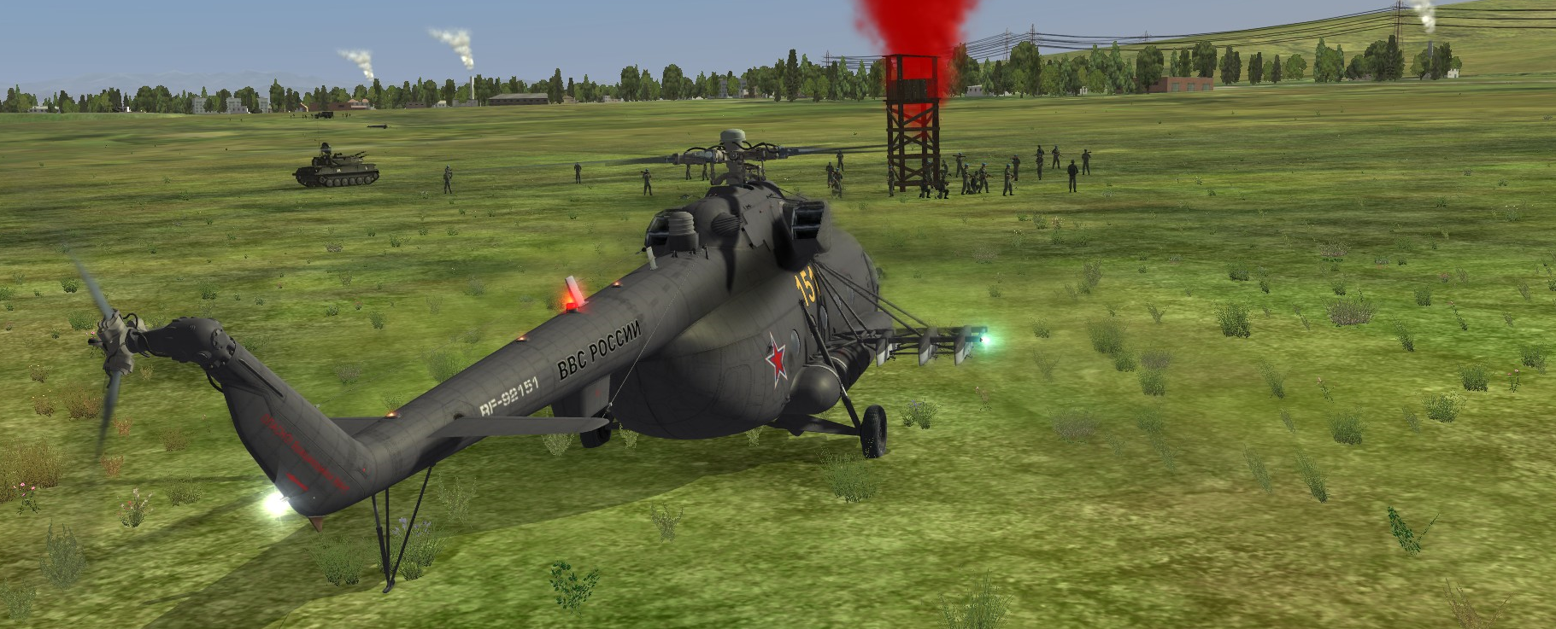
General Info
Different types of cargo - different behaviour …
In order to be able to pickup or load cargo, it is required to fly within the landing zone and land the helicopter. The same counts for unloading or deploying cargo. However, each cargo has different behaviour when loading or picking up cargo:
Infantry troops runs to your stationed helicopter when loading. You need to land within a range of 100 meters from the infantry. Once the infantry received the instruction to load, and has started to run, you need to WAIT until all infantry is loaded.
Packages are delivered by a delivery vehicle or infantry. Wait until the vehicle has delivered the package.
Sling loaded cargo is being handled by following the standard sling load process.
Next Page ➔

Slide 18
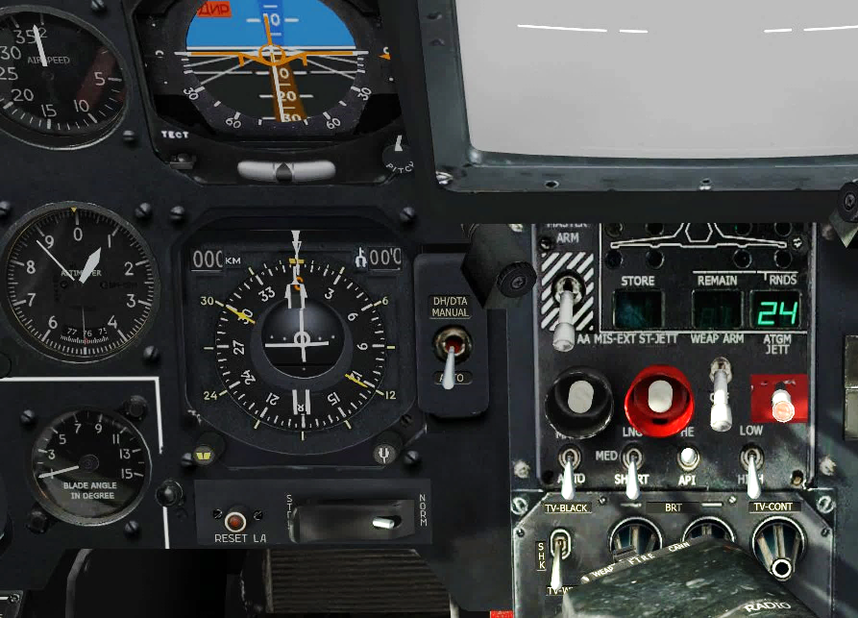
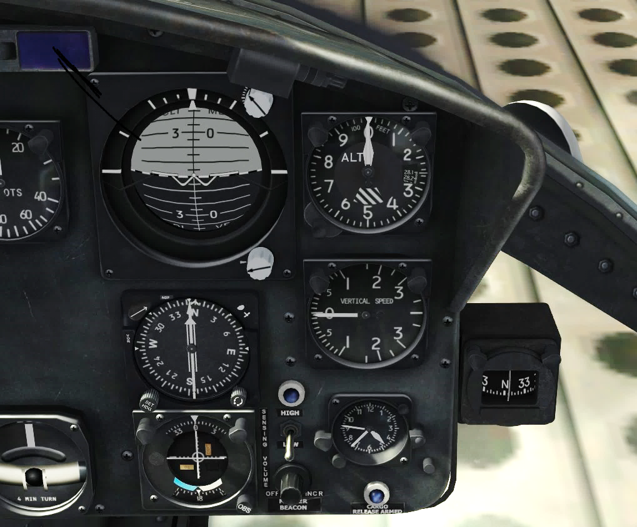
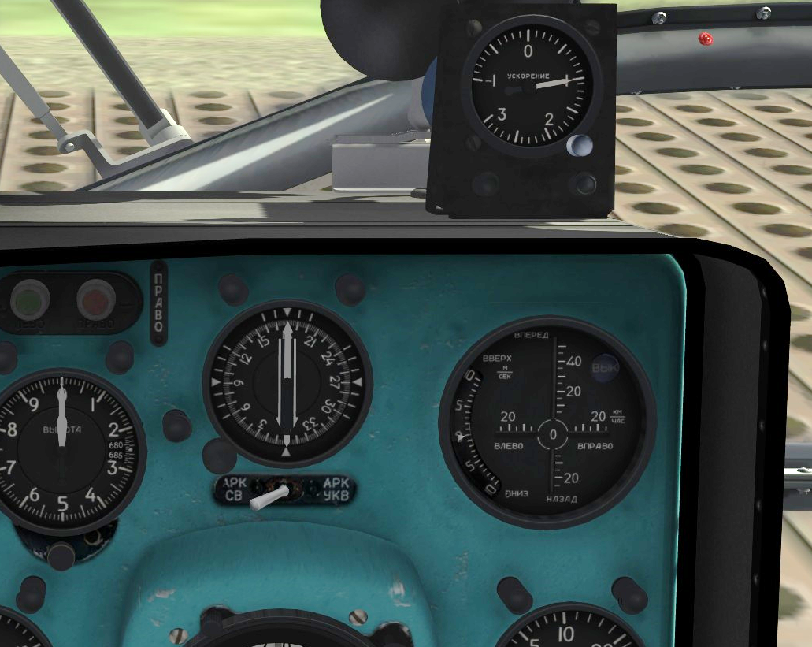
Radio compass indicators
General info
Flight directions.
KA-50
UH-1H
Your co-pilot will indicate directions of flight in terms of the angle in degrees of the direction to fly, and the distance in km to the zone. Your helicopter is equipped with a radio compass indicator instrument, that provides you with the heading of your helicopter. Use this instrument to turn your helicopter to the correct zone.
MI-8
Next Page ➔

